Slide 1
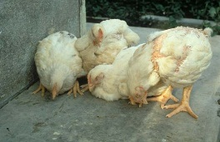
poultry diseases 2
fourth stage
شعار الكلية
second semester– lecture 4 part 1
Fowl Pox
Dr.Harith Abdulla
Department of Pathology and Poultry Disease
College of Veterinary Medicine University of Basrah
University of Basrah- College of veterinary medicine- Department of Pathology and Poultry Disease

Slide 2
Fowl POX ( Avian POX )
An infectious disease of avian species ,characterized by wart-like nodules on the skin and diphtheritic membranes in mouth, larynx , esophagus and trachea. The disease may occur in any age .
Incubation period :( 6-14 ) days .
Course of the disease :( 3- 4 ) weeks.
Mortality : About 1-2% .

Slide 3
Etiology:
Virus: Belongs to the Avipoxvirus ,family Poxviridae .
Types of virus:
Fowl poxvirus ( chicken poxvirus ) .
Turkey poxvirus.
Canary poxvirus
Quail poxvirus.
Pigeon poxvirus.
There is some cross species infectivity with the various
viruses with the exception of canary poxvirus which specific
for canaries.

Slide 4
Method of spread
Mechanical transmission by: a. Mosquitoes. b. Biting insects .
By contact through abrasions.
Aerosol.

Slide 5
Clinical signs:
There are three forms of the disease :.
1- Skin form : Dry pox ( Cutaneous form ): Shows wart-
like lesions on the comb, wattles, eyelids and other unfeathered parts of the body .It starts as whitish foci which develops into nodules,then sloughed and scab appear before final healing .
2-Diphtheritic type: Wet pox .Yellow patches on the surface epithelium of mouth , larynx ,trachea and esophagus. Removing of these lesions left eroded or ulcerated area.
3-Coryza –like form : Infection of the nasal chambers
accompanied by Coryza-like signs

Slide 6
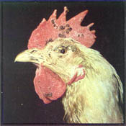

Slide 7
Post mortem lesions:
Same as signs

Slide 8
Differential diagnosis
Vitamin A deficiency.
Infectious Coryza.
Infectious Bronchitis.
Infectious Laryngotracheitis.
Mycoplasmosis.
Newcastle Disease ( Respiratory form)
Aspergillosis
Airsacculitis.
Avian Influenza ( Respiratory signs )
Trichomoniasis.
Physical damage.

Slide 9
Diagnosis:
Typical lesions .
Histopathology : Intra-cytoplasmic inclusions with ballooning degeneration.
Viral isolation.
Experimental infection.

Slide 10
Treatment: No treatment. Removal of scabs around the eyes or mouth will facilitate eating or drinking.
Prevention:
Vaccination.
A-Fowl poxvirus vaccine : More virulent.
B- Pigeon poxvirus vaccine : Less virulent
2. Both vaccines are given via the wing-web .

